Slide 1
Investigating Students Affective States using Affective Survey Software
Evie Stokes

Slide 2

Project Motivations
The Computer Science 1 (CS1) course is critical for success in computer science at the university level
Affective state, which refers to an individual's emotional state, has been explored as a potential predictor of performance in CS1.
Peers play a considerable role in the individuals opinion of how they are performing in CS1
The momentary nature of affective states can make their measurement challenging.
Survey software should be developed to allow students to be introspective and identify their emotional experiences
Notes:
The CS1 course predicts success
In cs2 and other future computer science endevours
As such want to investigate, why do many drop out and fail
Affective state has been heavily associated with cs1 as researchers describe students feeling an emotional turmoil while completing programming tasks
Students in cs1 think theyre bad at programming, not always the case, leading to drop outs.
If they had knowledge of peers, would they still think theyre bad?
They should be able to decipher how they perform poorly affectively and if their emotional state regarding a lab is one of concern

Slide 3
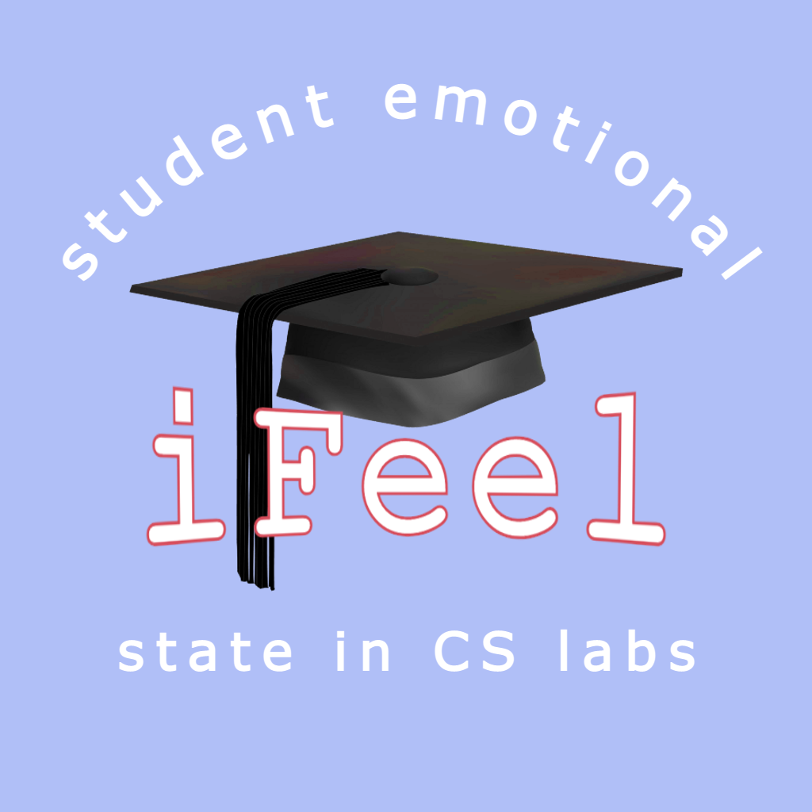
Aims
To create an application, iFeel which would survey student emotions after labs
Offer comparisons with other students and tutors expectations
Open dialogue between students and tutors
Notes:
Gain a more clear perspective on relative performance

Slide 4
Literature Review
Studies suggested that students who are more novice to programming may have a more skewed perception of how they are performing
More frequent moments of negative self assessment leads to lower performance
Transparency on students’ affective state relative to other students may provide an earlier indication of falling behind and provide the opportunity to self regulate at an earlier stage
Notes:
Novice programmers may not find it easy to compare themselves to peers as those most vocal in CS1 will be those with most experience
negative self assessment could be in the form of feeling demotivated after finding a lab hard
Relative affective state could allow students to self regulate and make valuable comparisons

Slide 5
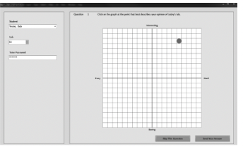
Existing Applications
Student affect tool
Couldn’t be accessed from anywhere but university machines
Did not provide insight into responses for students
Notes:
Only tutor based

Slide 6
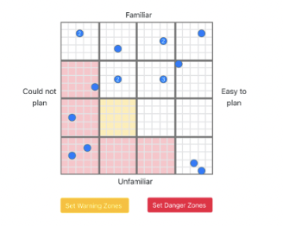
Check in
Provided feedback from tutor
Did not give insight into other students
Web application, not as accessible for students to report emotions in momentary fashion
Notes:
Sms survey showed that mobile responses to a sms were received quickly as they were accessible from the mobile device

Slide 7
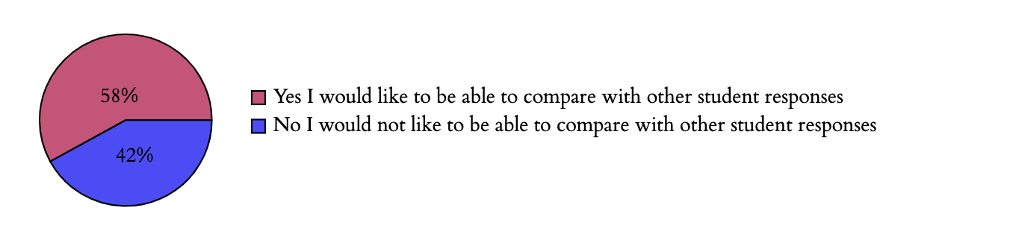
Requirements survey
Investigated the importance of elements on the draft list of requirements
Found that most students would like to be able to compare their affective state with other students
Notes:
12 participants agreed or disagreed with statements about what was important to them in affective survey software

Slide 8
Requirements
Organised with MoSCoW prioritisation method
Main MUST HAVE requirements were
Dashboard for tutor and students
Students reply to a survey on a 2D grid with negative and positive axes
Survey provides feedback based on other students’ responses to the same survey
Survey provides feedback based on other tutor defined risk zones
Shows feedback in plain English

Slide 9
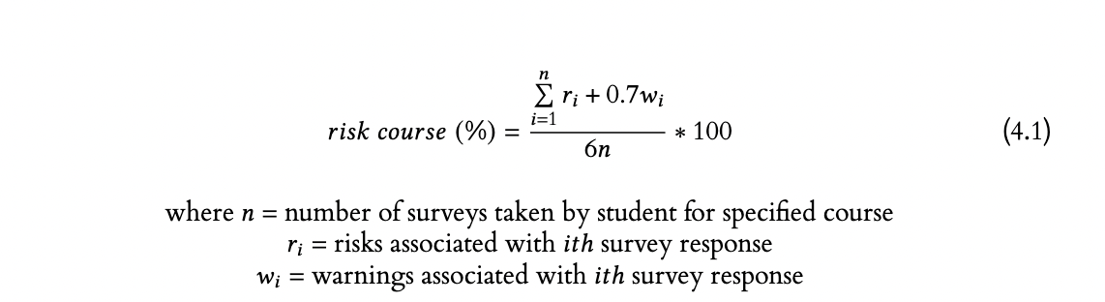
Design
Algorithm design

Slide 10
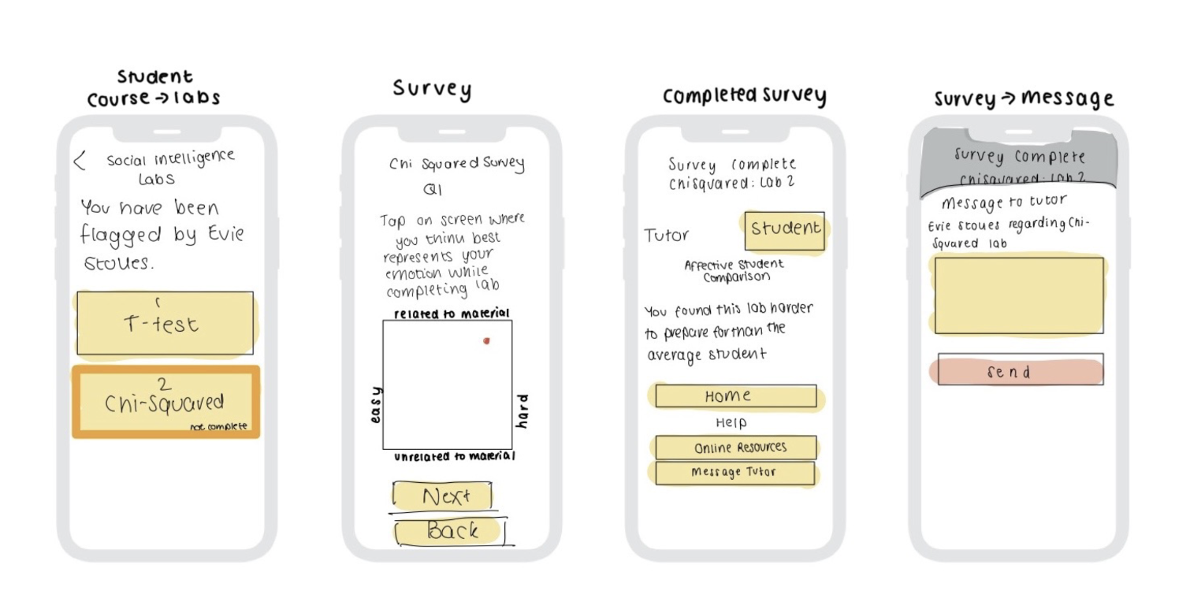
Wireframes

Slide 11
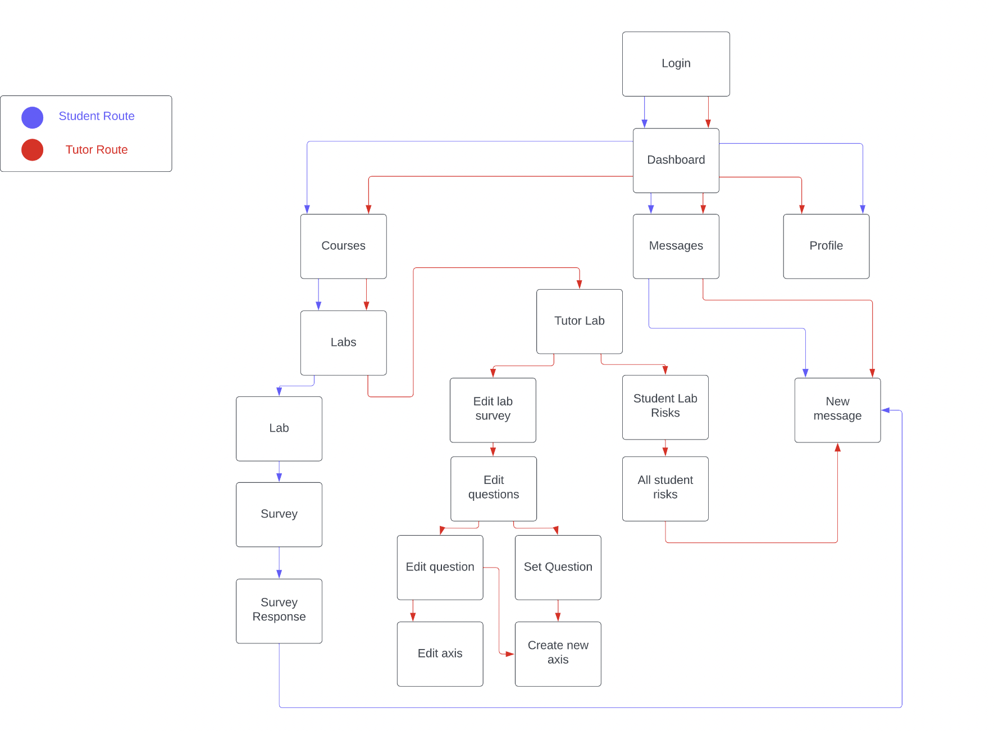
Sitemap

Slide 12
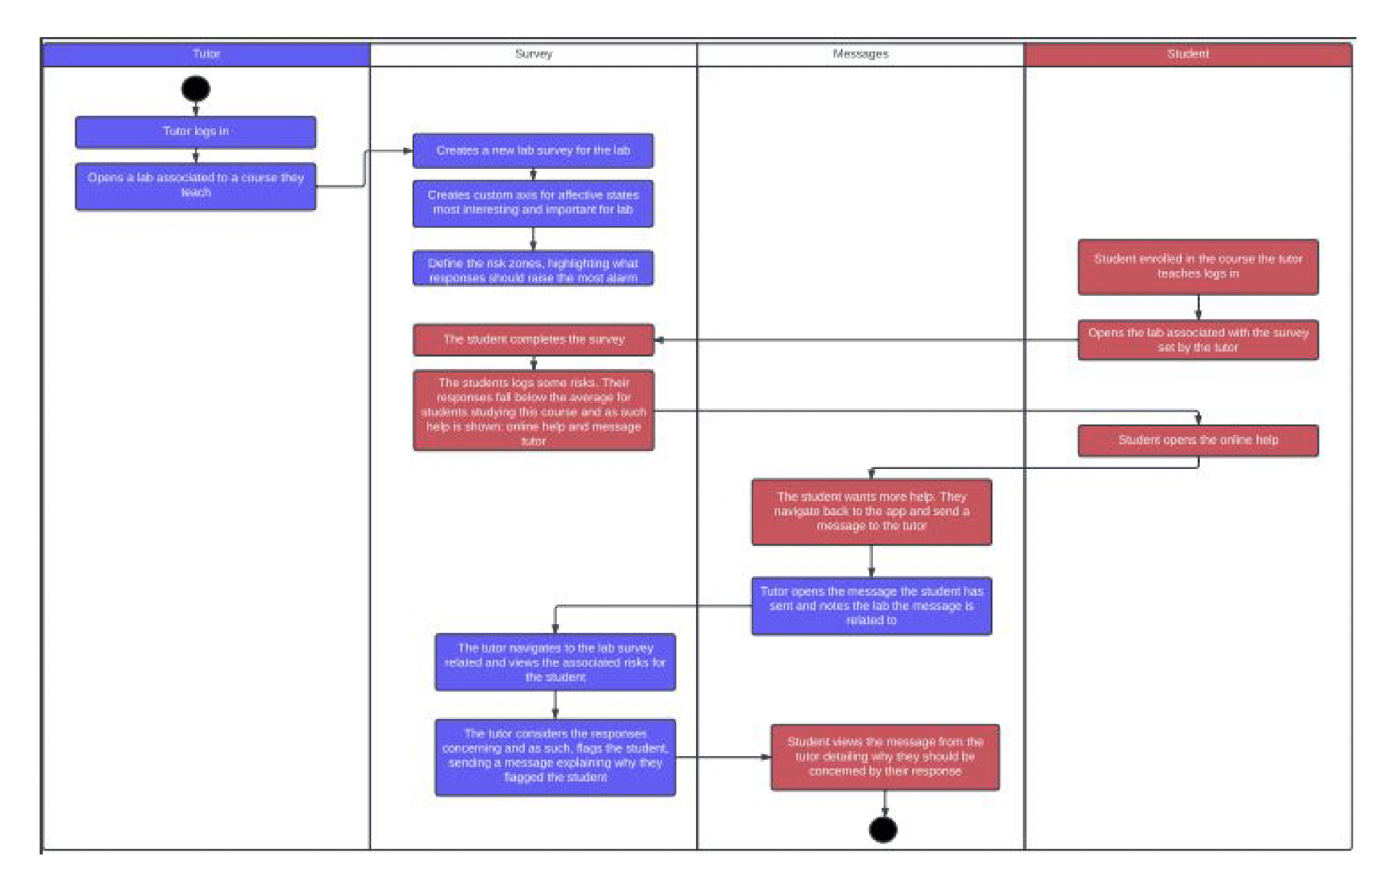
Activity Diagram

Slide 13
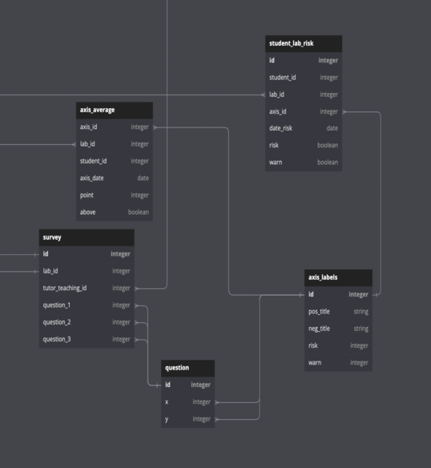
Database design
Entity Relationship diagram used to present the relationships to configure in the back end database

Slide 14
Development Process
Waterfall technique
With manual testing
With continuous integration
Feature Branching
Version control

Slide 15
Implementation
Front end
Expo
React Native
JavaScript

Slide 16
Implementation
Backend
Django
Django REST framework

Slide 17
JWTokens
Used to authenticate user requests made to Djano REST endpoints

Slide 18
Django models
ORM features
Relationships between objects made it easy to perform tasks such as finding a students associated risks

Slide 19
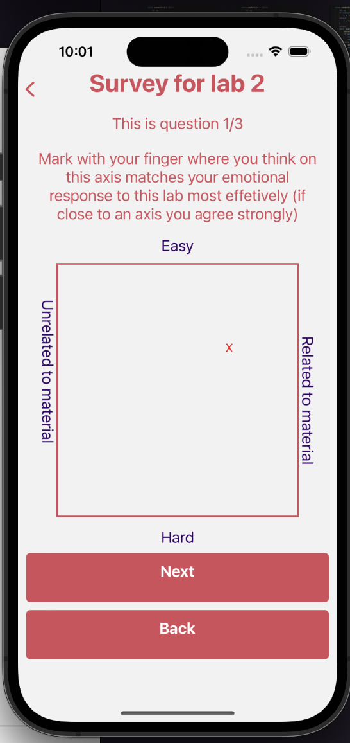
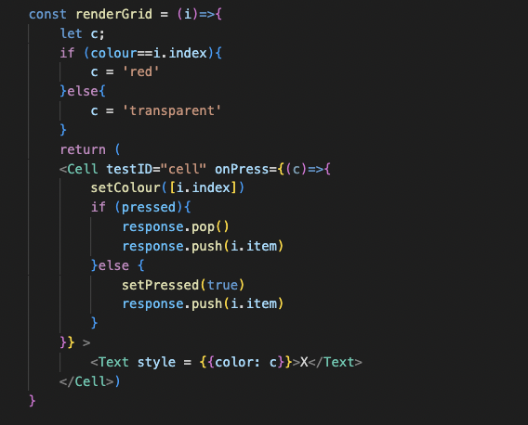
FlatList implementation of the 2D grid

Slide 20
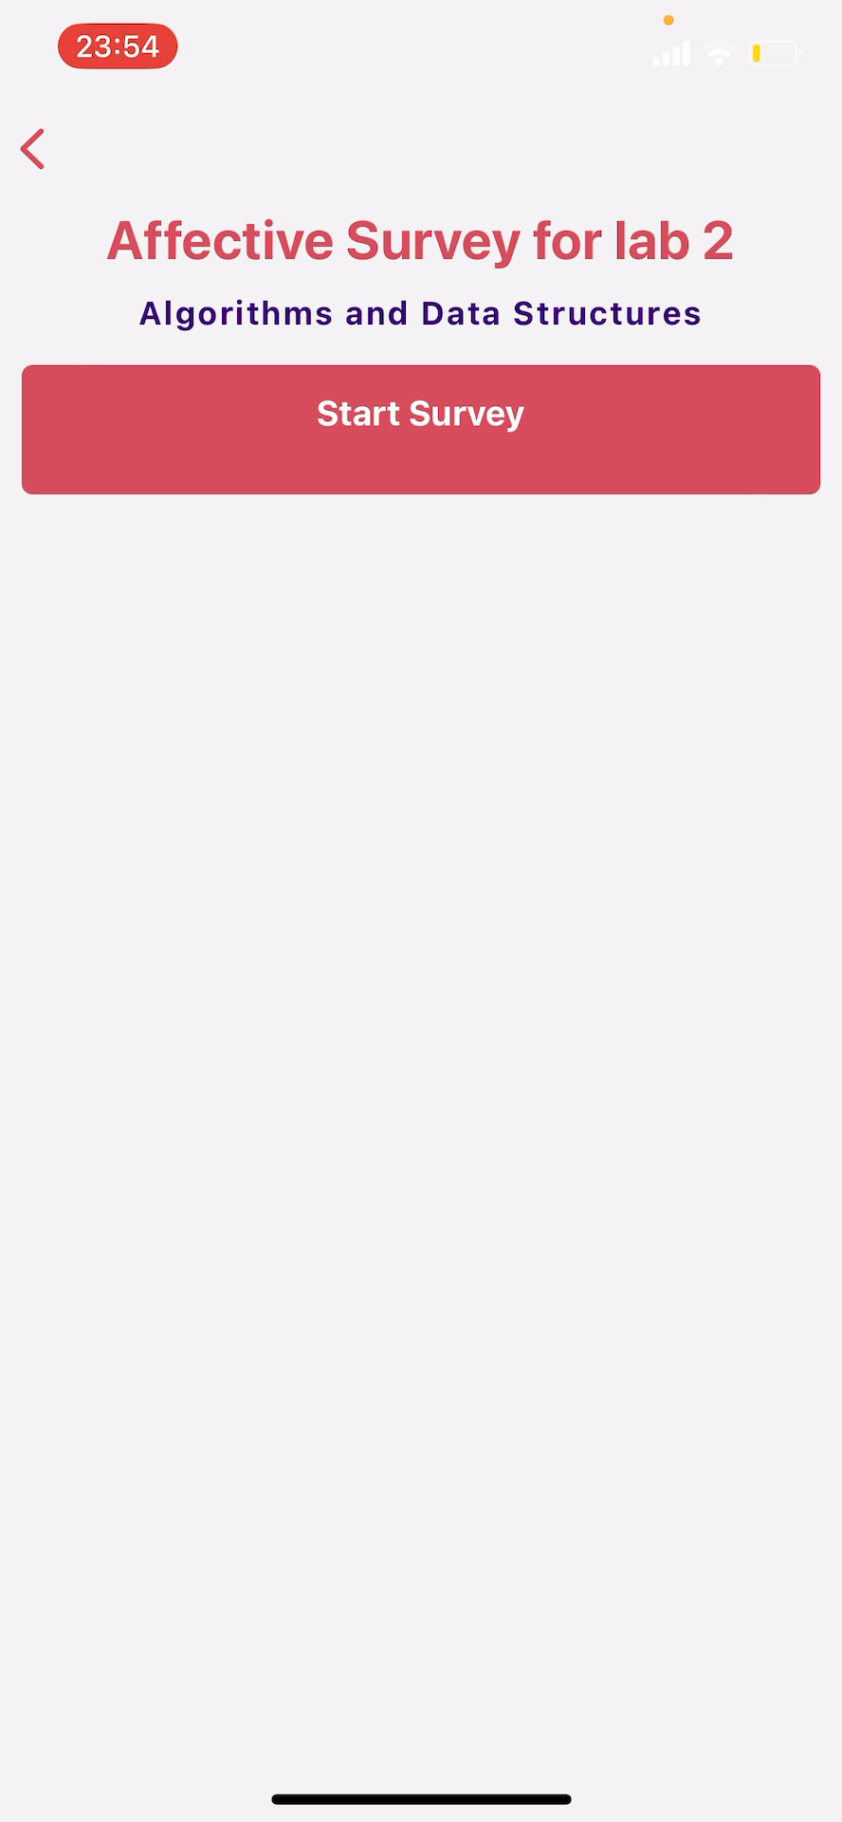
Demo
Demo of survey

Slide 21
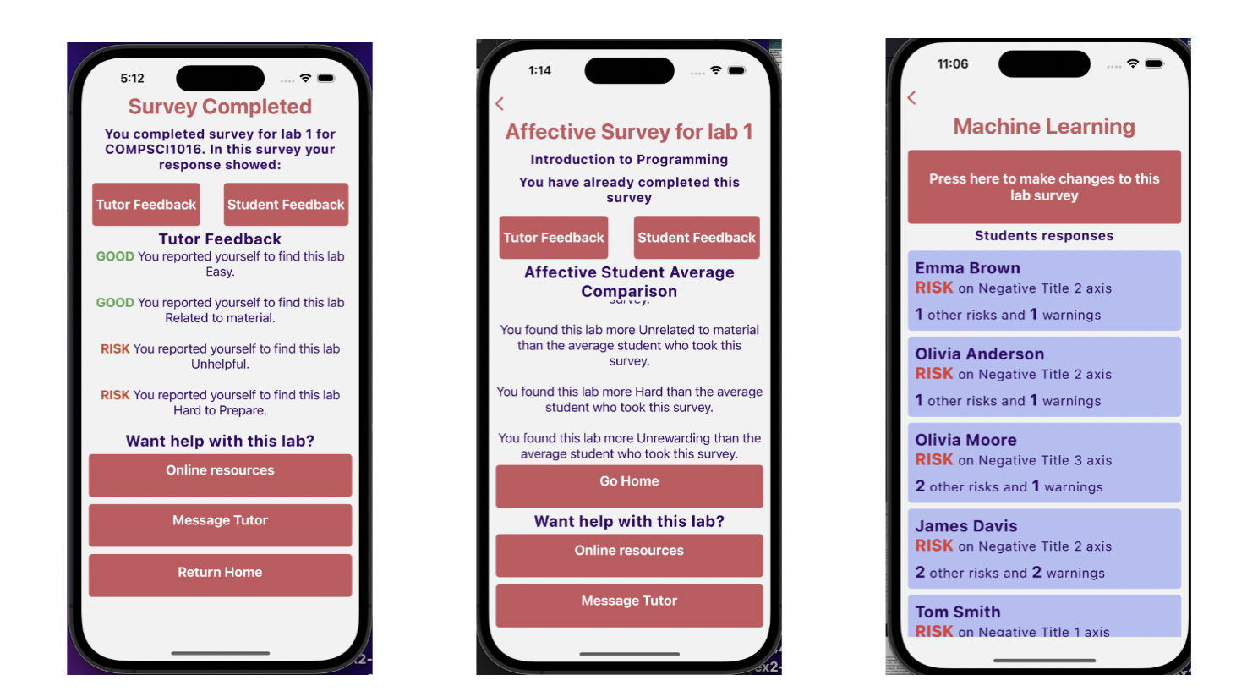
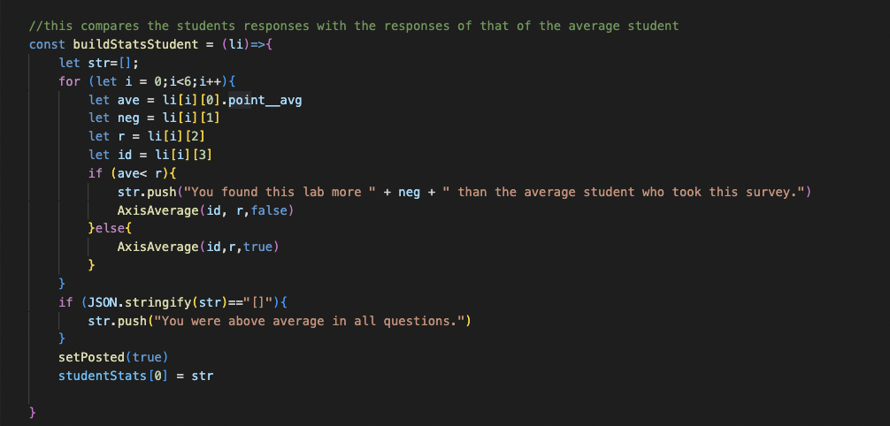
Displaying Risks

Slide 22
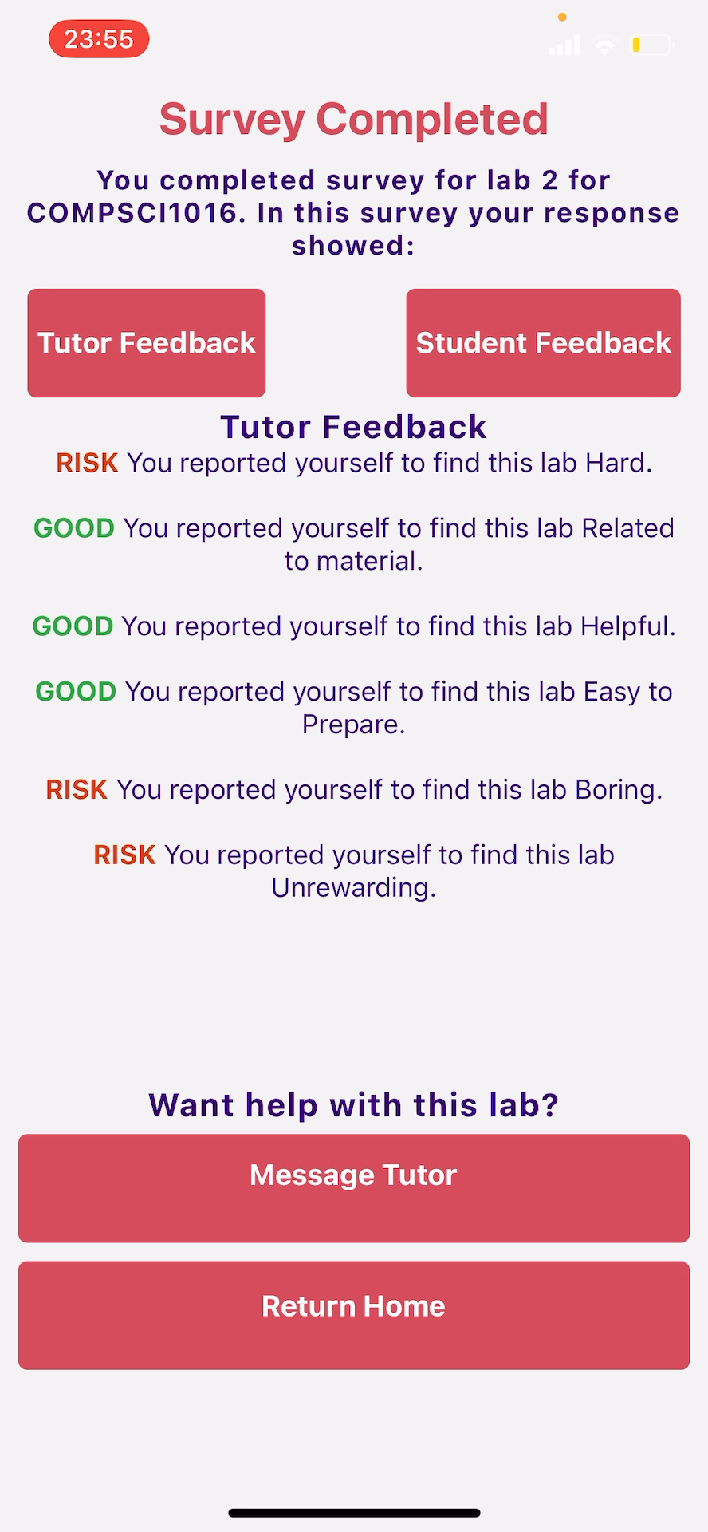
Demo
Risk Display

Slide 23
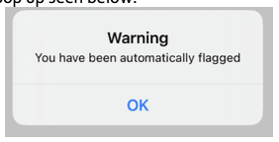
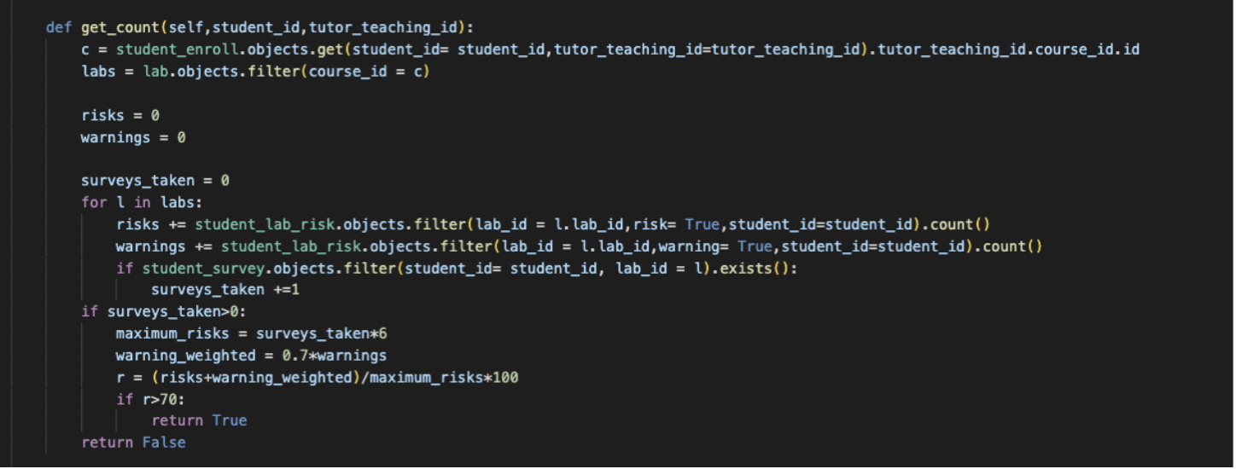
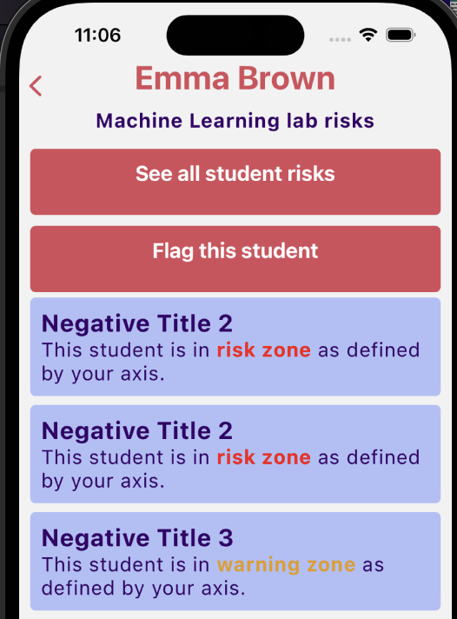
Flagging Students
Automatically

Slide 24
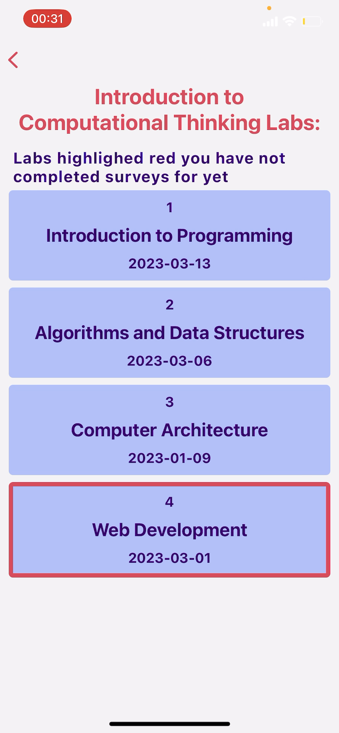
Demo

Slide 25
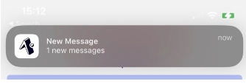
Notifications
Used to inform tutor of messages
Pilot implementation

Slide 26
Manual Testing
Django Testing
Jest Testing

Slide 27
Evaluation
2 Experiments were carried out to evaluate the system usability and iFeel’s ability as affective survey software for CS1 students

Slide 28
Evaluation
Demonstration survey
The participants were asked to watch videos of a demonstrator completing the same tasks, split into tutor and student
The videos would take a total of 5 minutes to complete
Scenario testing survey
Participants asked to complete tasks and report a completed, could not complete or other status regarding the task at hand

Slide 29
Tasks
Examples
Navigate to courses, then choose course "Introduction to Computational Thinking" and go to a lab that has already been completed
Click the student feedback and view it
Click the tutor feedback and view it
If there is a help link listed for "online resources" for this survey, click the button to follow the link

Slide 30
Questions
10 questions on the System Usability Scale, 8 for the demo survey participants as they could not respond to questions about first hand experience. How far do you agree with the statement “I thought the system was easy to use”
Qualitative questions regarding the system, “What did you like about the system?”

Slide 31
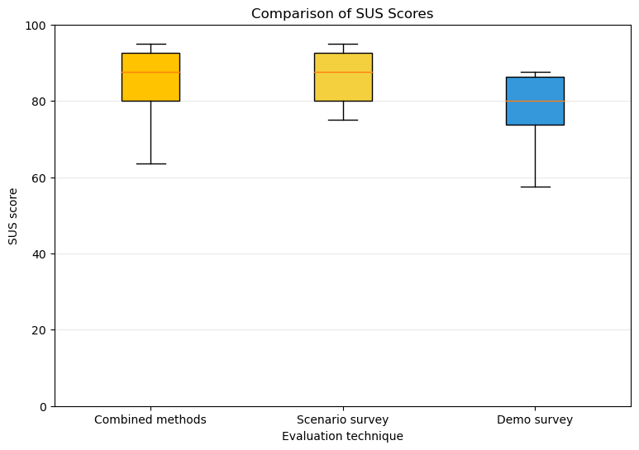
SUS responses

Slide 32
Qualitative Feedback
’Very well presented...’, ’...intuitive’, ’Seemed quite straight forward’, ’looks very simple to use’, ’Clear titles’
Positive feedback regarding survey instrument
Intuitive feedback on how axis titles should be set in a less time consuming manner

Slide 33
Ability to measure affective state
Most participants agreed with the statement “I found the survey method and feedback provided an effective method of determining my affective state regarding a lab’”

Slide 34
Limitations
Demographic was skewed to a number of non computer science students taking part in the survey, due to the nature of a convenience sample.

Slide 35
Conclusions
The project completed its goal and fulfilled all high priority requirements
Future:
Push notifications
Bulk upload of students
Reflections

